Slide 1
Two Dimensional Arrays
7.6

Slide 2
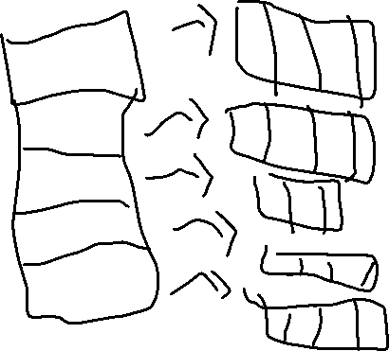
Arrays in two dimensions Essentially a table
C0 C1 C2
R0
R1
R2
R3
R4
R5

Slide 3
Syntax
int values[][]=new int[rows][colums];
Example:
int values[][]= new int[6][3];
C0 C1 C2
R0
R1
R2
R3
R4
R5

Slide 4
Can initialize
int data[][]={{1,2,3},{4,5,6},{7,8,9},{10,11,12}};
Creates this array:
What element is at data[1,2]? 6
data[2,1]? 8
1 | 2 | 3
4 | 5 | 6
7 | 8 | 9
10 | 11 | 12

Slide 5
Getting length
String data[][];
data.length returns the number of rows
data[].length returns number of columns
EVERY ARRAY WE DO IN THIS CLASS WILL BE RECTANGULAR (THERE WILL NOT BE ROWS WITH VARYING LENGTHS)
EVERY YEAR, THERE IS ONE FRQ ON TWO DIMENSIONAL ARRAYS, WHICH IS 12.5% OF YOUR SCORE, SO STUDY THIS!!!!!!

Slide 6
To cycle through 2D arrays you need 2 nested for loops
int[][]data = new int[4,3];
for(int i = 0; i<data.length;i++)
{
for(int j = 0; j<data[].length; j++)
{
data[i][j]=(int)(Math.random()*10+1);
}
}
GOES LEFT TO RIGHT, THEN TOP TO BOTTOM

Slide 7
2016 AP Question

